Slide 1
ShanghaiTech University
EE 115B: Digital Circuits
Fall 2021
Lecture 19
Hengzhao Yang
December 21, 2021

Slide 2
Chapter 8 Synchronous sequential circuits
Sequential circuits
  Also called finite state machines (FSMs)
  Output depends on past behavior and present input

Slide 3
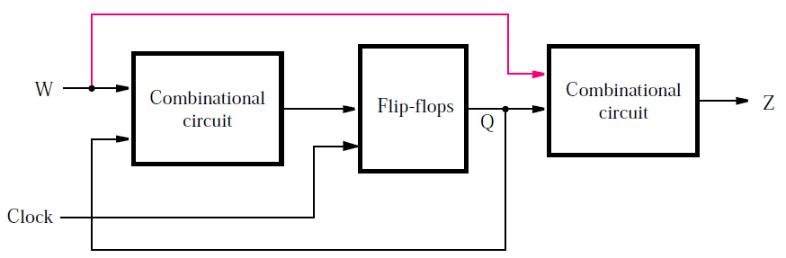
Sequential circuits
General form
  Using combinational circuits and flip-flops
  Input: W, output: Z, state: Q
  Active clock edge: edge causing state change

Slide 4
Sequential circuits
Two types
  Moore: output depends only on state (without red line)
  Mealy: output depends on both state and input (with red line)

Slide 5
Synchronous sequential circuits
Design flow
  Example: sequence detector
Moore FSM
Mealy FSM

Slide 6
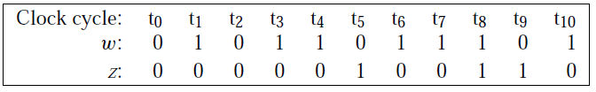
Sequence detector
Design specifications (problem statement)
  Circuit has one input (w) and one output (z)
  All changes occur at positive clock edges
  Operation: z=1 if w=1 during two immediately preceding clock cycles; z=0, otherwise

Slide 7
State diagram
Identify states to describe circuit behavior
  State A (starting state): when a reset signal is applied or w=0, circuit enters this state, z=0
  State B: w=1 for one clock cycle, z=0
  State C: w=1 for two clock cycles, z=1

Slide 8
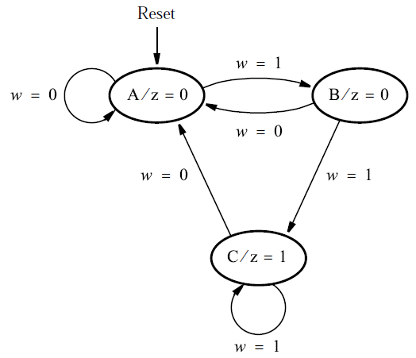
State diagram
State diagram
  Nodes: states
  Directed arcs: state transitions

Slide 9
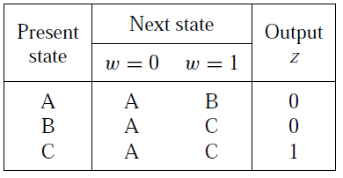
State table
Convert state diagram to state table
  First state is starting state (state A)
  Present state, next state, and state transitions
  Output is specified with respect to present state

Slide 10
State assignment
Each state is represented by a combination of state variables
Each state variable is implemented by a flip-flop
Three states (A, B, C) need two state variables (y₁, y₂)
Moore type: output only depends on state
Present-state variables: y₁, y₂
Next-state variables: Y₁, Y₂

Slide 11
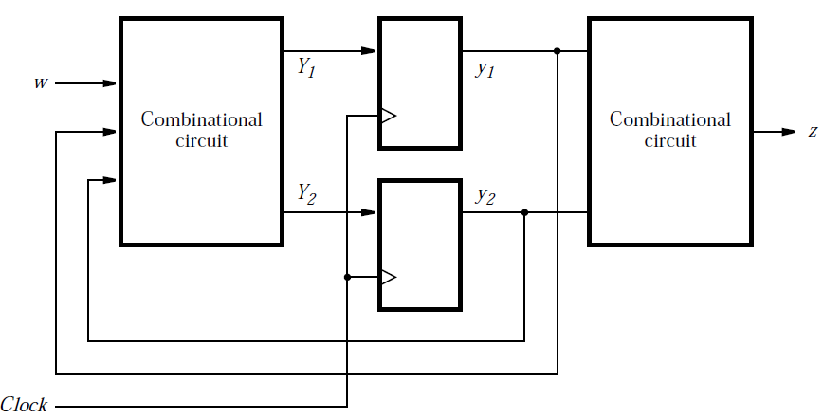
State assignment
Circuit block diagram

Slide 12
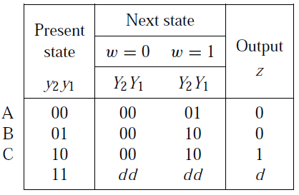
State-assigned table
Assign binary values to states
  A: 00, B: 01, C: 10
  “11” is not used

Slide 13
Choice of flip-flops
D flip-flops: transfer Y₁ and Y₂ to y₁ and y₂

Slide 14
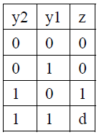


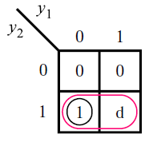
Output expression
Output expression: z
  Ignoring don’t cares:
  Using don’t cares:

Slide 15
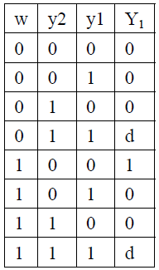


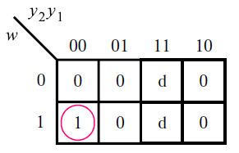
Next-state expressions
Next-state expression: Y₁
  Ignoring don’t cares:
  Using don’t cares:

Slide 16
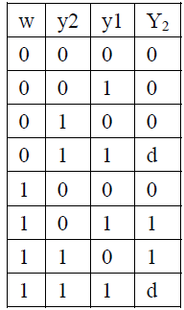


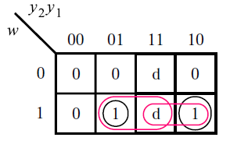
Next-state expressions
Next-state expression: Y₂
  Ignoring don’t cares:
  Using don’t cares:

Slide 17
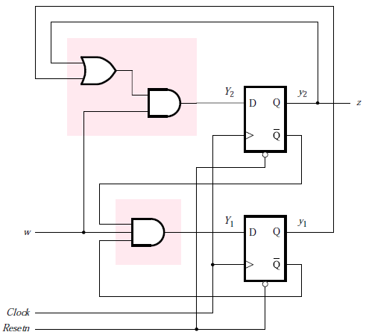
Circuit (using don’t cares)
Output
Next-state

Slide 18
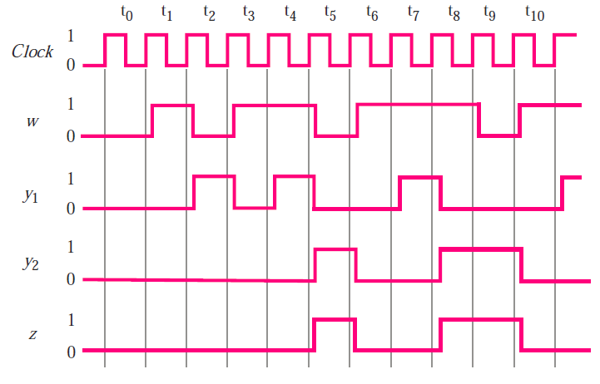
Timing diagram

Slide 19
Summary
Design steps
  Understand design specifications
  Identify states to describe circuit behavior and draw state diagram for states and transitions
  Convert state diagram to state table
  Assign state variables
  Choose flip-flops and determine output and next-state expressions
  Implement circuit

Slide 20
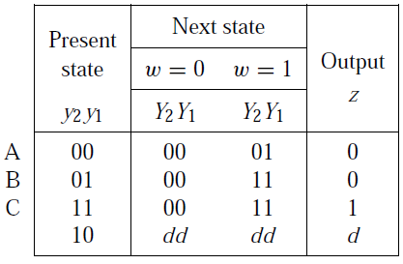
State-assignment issue
Original state assignment
  A: 00, B: 01, C: 10
  “11” is not used
Alternative state assignment
  A: 00, B: 01, C: 11
  “10” is not used

Slide 21
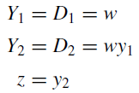
Output and next-state expressions
Expressions

Slide 22
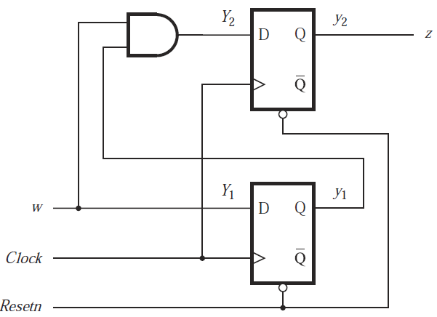
Circuit (with a lower cost)
Expressions

Slide 23
One-hot encoding
One-hot encoding
  Another approach to assign states
  Number of states equals number of state variables
  For each state, only ONE state variable is “hot”: its value is “1”. The values of all the other state variables are “0”.

Slide 24
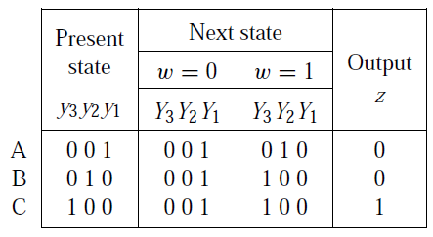
Example
State table
  Three states: A, B, C
One-hot state assignment
  Three state variables: y₃, y₂, y₁
  A: 001, B: 010, C: 100
  Other combinations of state variables are don’t cares

Slide 25
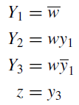
Example
Output and next-state expressions
Circuit is not simpler for this example
One-hot encoding is useful in many cases

